Slide 1
Developing a data warehouse and business Intelligence system for human capital management at
CONSUMER PRODUCT
Team E :
Prof. Joseph Morabito Course: MIS 636-Spring 2015

Slide 2
CONSUMER PRODUCT
World’s third largest consumer product company
Products include food, beverages, cleaning agents and personal care
Products available in over 190 countries with 400 different brands
Basic operations:
Production, marketing and distribution
Research and development
Human capital management
Information Technology
Finance and other office functions

Slide 3
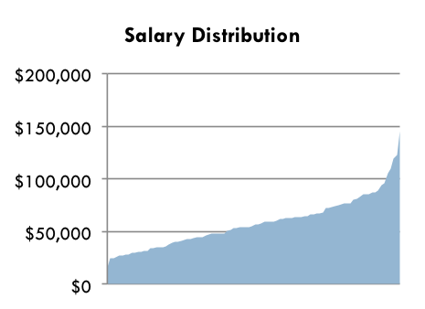
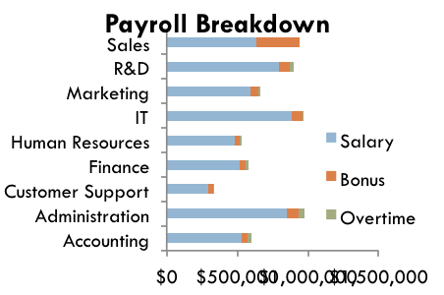
Overview
High Level Design
  Human capital management
  Employee data
  Bus Architecture
  Sequence of Construction
Development of Data Mart
Logical Dimension Model
  Star Schemas
  Grain
  Conformed Dimensions
Slowly Changing Dimensions
Transformation Rules
Aggregate Table
OLAP Cube
Role Specific BI Portal
Conclusion
References
  Objective
  Project Methodology
Key Findings/Results
  Results 1
  Results 2
Conclusion

Slide 4
Human Capital Management
Recruitment
Selection and on-boarding
Training and development
Compensation and benefits
Performance management
Talent management
Leadership development
Exit

Slide 5
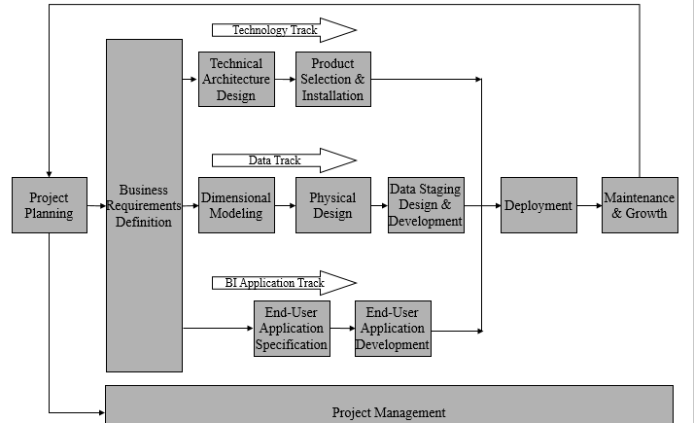
Business Life Cycle Approach

Slide 6
Prioritization Grid
High
Recruitment
Exit
Compensation
Perf. Mgmt
Potential
Business Impact
Training & Dev
Low
Low
High
Feasibility

Slide 7

Consumer Product – Opportunity Matrix
Organization/Work Groups
BUSINESS PROCESS | FINANCE | OPERATIONS | HR | CUSTOMER SERVICE | LOGISTICS | PRODUCTION | MARKETING
Recruitment
Selection and on-boarding
Training and development
Compensation and benefit
Performance management
Talent management
Leadership development
Exit procedures
Notes:
This slide identifies the different Organization Work Groups that participate in various Business Processes.

Slide 8
High Level Bus Architecture
High Level Enterprise DW Bus Matrix for Centralized and Consistent Data
Conformed Dimensions
BUSINESS PROCESS | EMPLOYEE | MANAGER | TIME | DEPT | LOCATION | ROLE | POLICY
Recruitment and selection |  | X | X | X | X | X | X
Training and Development | X | X | X | X
Compensation-Benefit |  | X | X | X | X | X
Performance Management | X | X |  |  |  |  | X
Exit | X | X | X | X |  |  | X

Slide 9
Steps to Dimensional Modeling
1 | Choose a Business Process and its data | A Business Process is chosen as a Fact Table Design the DW by the Business Process not the Business Unit Unilever – Recruitment and Selection
2 | Choose the Grain of the Business Process | Represents one row of the Fact Table Choose the lowest possible grain, aggregate to higher levels Unilever – Each new hire role_location in fact table
3 | Choose Dimensions of the Business Process | Dimensions explain Fact tables Represent Query Entry-Points into the Star Schema Each Dimension has several Attributes Unilever – Time, employee, location in the fact table
4 | Choose the measured Facts | Facts are numeric fields that populate each fact table record Unilever – employee salary and compensation offered

Slide 10
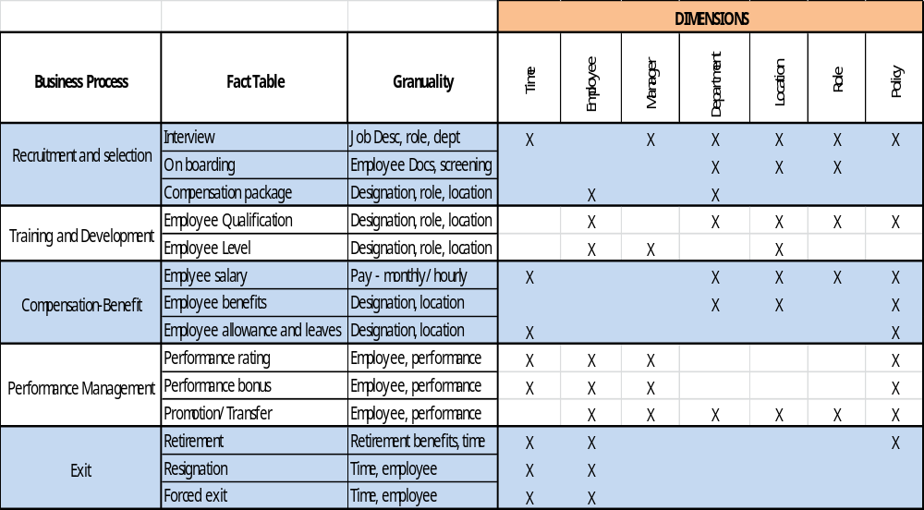
Detailed Bus Matrix

Slide 11
Logical Fact Table Diagram
Date and Time
Job Role
Employee ID
Job
Description
Interview Process
Job desc
Fact Table
Grain:
Job desc of Interview Process
Manager
Candidate profile
Designation
Dept
Sub
Division
Finance
Location
Salary

Slide 12
Detailed Fact table: Interview Process
Interview Fact Table
Candidate Profile_key
Job Role_key
Salary_key
Location_key
Department_key
Manager_key
Date and Time_key
- Dimension Keys
- FK
Dimensions are the foundation of the fact table, and is where the data for the fact table is collected.

Slide 13
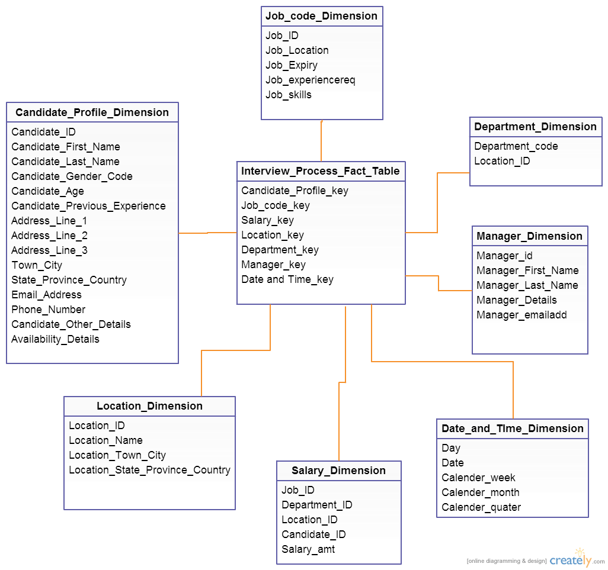
Star Schema

Slide 14
Dimension Table Detailed Diagram : Candidate Dimension
(500)
Job Role
(500)
Manager
State/Region
Age range
(51)
Department
(6)
Time
Location
(50)
(7)
Gender
(700)
(2)
Candidate
Slowly Changing Dimensions:
Job Description
Salary range
(700000)

Slide 15
Dimension Attribute Detail Descriptions
Attribute Name | Attribute Description | Cardinality | Slowly Changing Dimension Policy | Sample Values
Candidate ID | Candidate ID that Uniquely identifies each Candidate within the HR | 700000 | Not updated | 000001-999999
Job Role | The full descriptive name of the Candidate job description | 500 | Type 2 | Vice president-Manger- Project Manager -
Salary range | The salary range that this job Takes per hour | 10 | Type 2 | 10-20,21-30,31-40,41-50,61-70,71-80,>150
Gender | The candidate gender | 2 | Not updated | Male-Female
Department | The full descriptive name of the Candidate Department | 50 | Overwritten | Enterprise Architecture, IT, Data modeling
Location | The full descriptive name of the department location | 700 | Overwritten | 10001 Point castle, Hoboken
State | The department state | 51 | Overwritten | New York – New jersey
Manager | The name of the manger for the candidate | 500 | Type 2 | Tomas David
Time | The month and year that Candidate needed | 7 | Overwritten | Apr2015
Notes:
Cardinality (describes the cardinality of the dimension if it exists),
Slowly Changing Dimension Policy, Reason (this describes the reason for the slowly changing dimension policy),
Sample Values (this describes an example of an attribute)
Slowly dimension changing policies are Type 1: when there is no need to keep the history of the data or when correcting the database
essentially it is an overwrite. Type 2: changes in dimensions and associating them with fact tables.

Slide 16
Conformed Dimensions
A conformed dimension is a dimension that means the same thing with every possible fact table to which it can be joined. A single conformed dimension table can be used against multiple fact tables in the same DB space, or a replicated conformed dimension can be used in more than one DB space:
Date and Time Dimension
Department Dimension
Location Dimension

Slide 17
Transformation Rules
a data transformation converts a set of data values from the data format of a source data system into the data format of a destination data system.
Rule Type | Description
Move | The data in source and destination has same data value & Format
Transform | The data in source would convert to match the destination format
Default | The data in source would be none so put the default data in destination table
Derive | Apply some rules on source data (arithmetic )to create destination data
Drop | A field from Source is not carried over to the destination field (to ensure that the given field was not forgotten)
Lookup | Use source field to access a populated table to determine if the value for the source field exists.

Slide 18
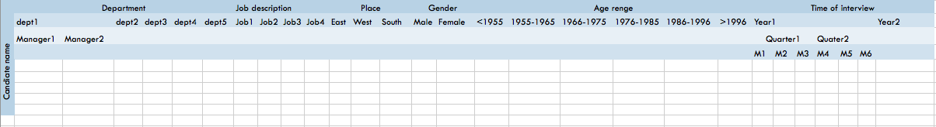
Aggregate Tables

Slide 19
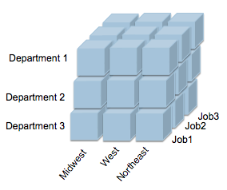
Candidate Cube

Slide 20
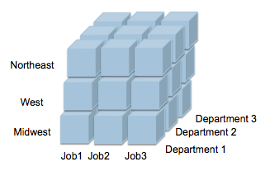
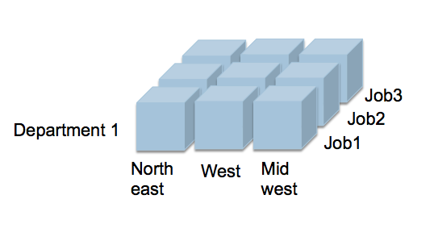
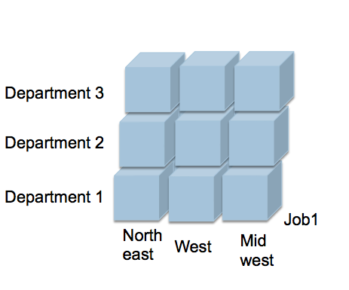
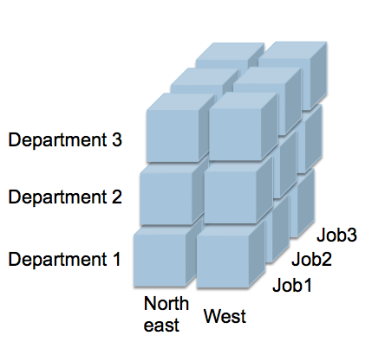
Candidate Cube
Drill down
Pivot
Slice
Roll up
Dice

Slide 21
User roles and delivery
User Role | Task Analysis | Delivery
Executives/Manager/Decision makers | Interested in summaries rather than day to day details. | Portal, Reports
Analyst | advance ad hoc query | Portal, OLAP ,MOLAP
Operational workers | Access to data details and create simple reports | Operational Reports
Knowledge workers | Enter day to day details and drill down capabilities | Portal

Slide 22
HR Dashboard
Use Tableau
Create Analysis report to analyze data

Slide 23
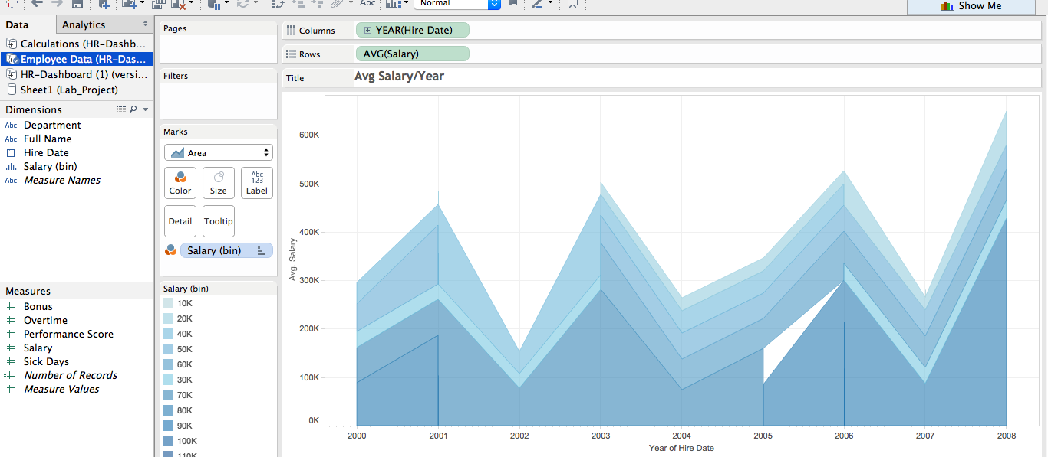
Average Salary / Year

Slide 24
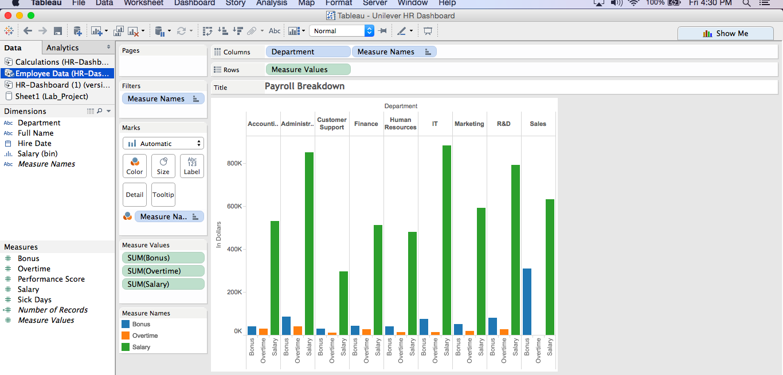
Payroll Breakdown

Slide 25
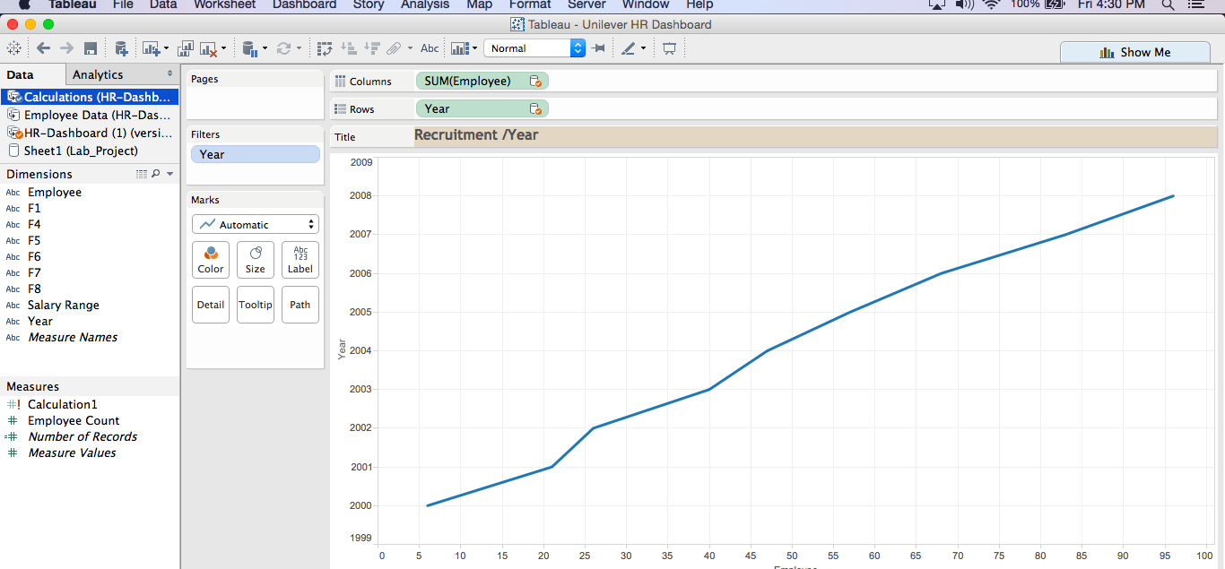
Recruitment / Year

Slide 26
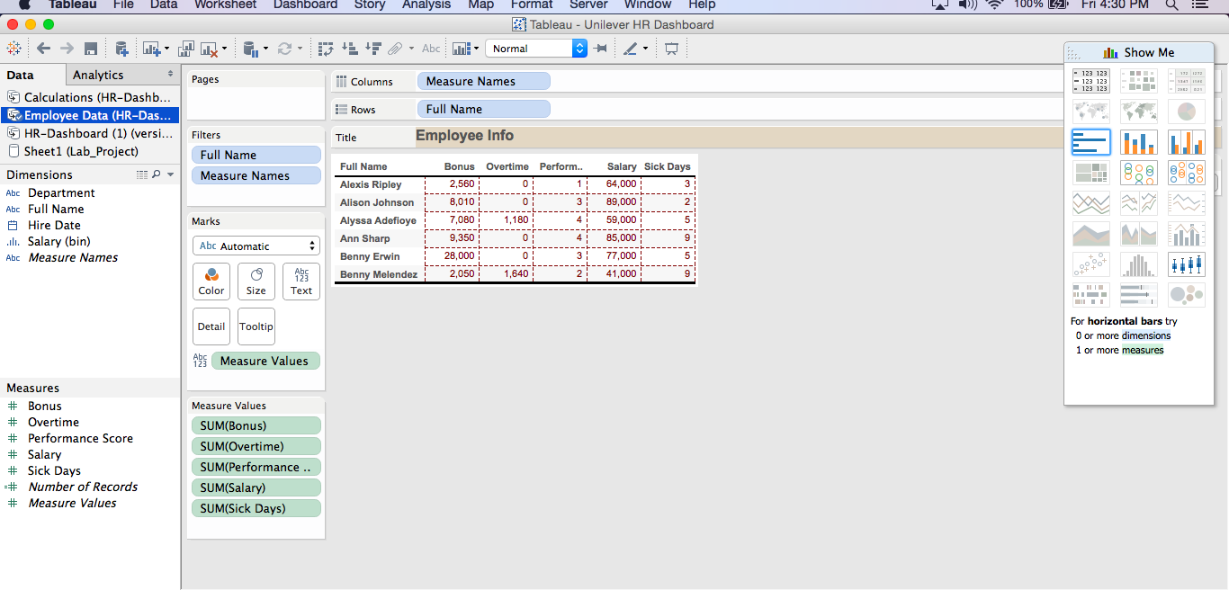
Employee Information

Slide 27
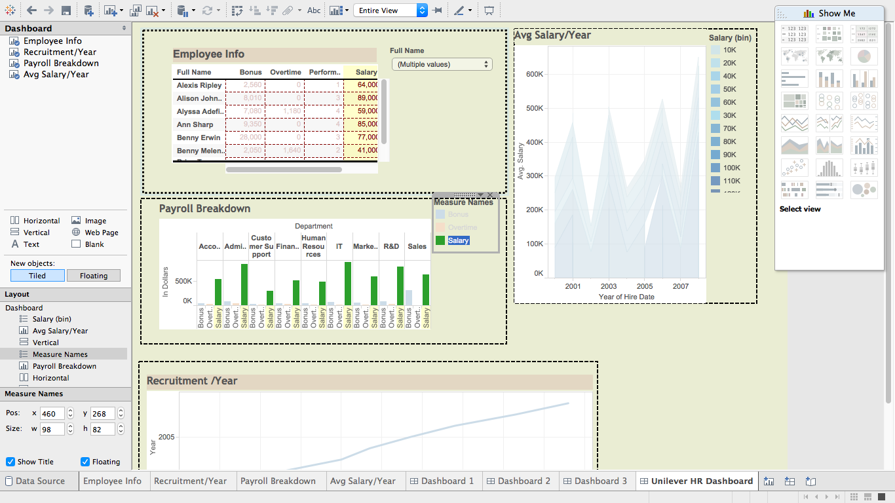
Unilever HR Dashboard

Slide 28
Tableau Public
Consumer Product HR Dashboard

Slide 29
Conclusion
The use of the HRM Analytics and Dashboards helps Unilever take important HRM decisions and forecast the future requirements
The big data about the company also helps to monitor employee productivity
Human resource utilization remains high
Metrics like Payroll Systems, Recruitment and Benefits help for leadership and government reporting

Slide 30
References
http://www.amazon.com/The-Data-Warehouse-Toolkit-Dimensional/dp/0471200247
Classnotes and discussions by Prof. Joseph Morabito
Tableau public software

